Slide 1
Dhairyakumar shah
ID - 22014212
ADS assignment 3
Here is the link of repository where you can find all the data of report with pytho file
link of repository
https://github.com/Dhairyakumarshah/ADS-3-assignment/upload

Slide 2
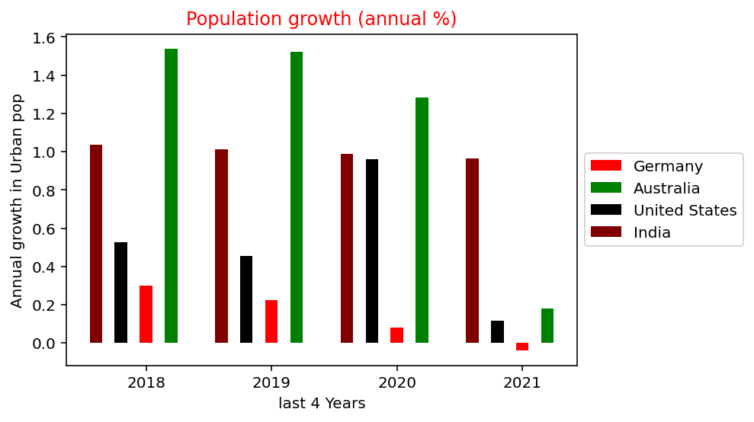
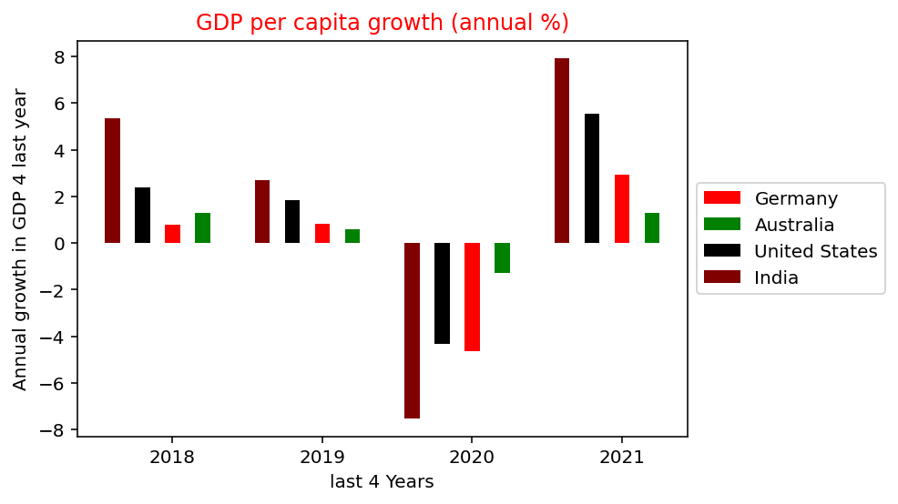
Population growth in urban areas and GDP per capita in 4 countries
On the right side, Bar compares the population growth in urban areas in selected 4 Countries from last 4 years. As an information, four countries is Germany, Australia, United states and India.
In this last 4 years. As a data we can see that from all 4 countries Australian citizens are more eagerly transferring their accommodations from rural to urban areas in recent 4 years.
On the left hand side, the bar graph compares the values of GDP per capita in 4 countries. As we all know that due to corona in the end of 2019 all countries are suffering in their financial conditions, which is clearly can be seen in the left plot.
All countries GDP was growing 2018 and 2019 but after in 2020 all 4 countries GDP grown reduced as we seen in left chart.

Slide 3
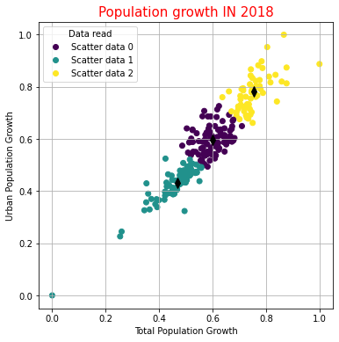
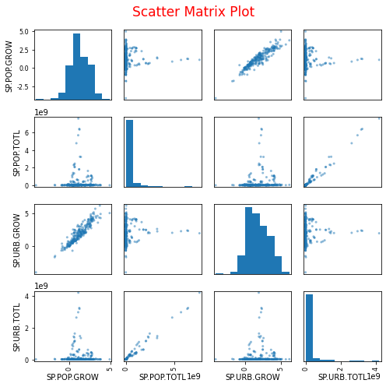
Population growth in the year of 2018.
Graph of Left side which is scatter chart,
shows that the Urban population growth.

Slide 4
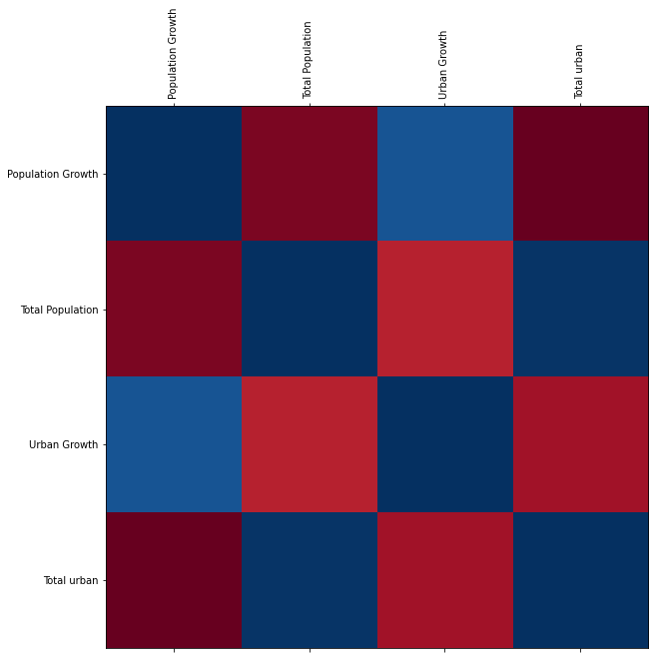
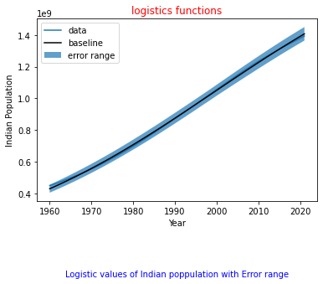
Population growth and total population

Slide 5
